Slide 1
Nb3Sn
SEM Top surface view – EDX composition
PCT – Gap Homogeneity
FIB/SEM-EDX – Not much to say for now
Transport in Field Perp.

Slide 3
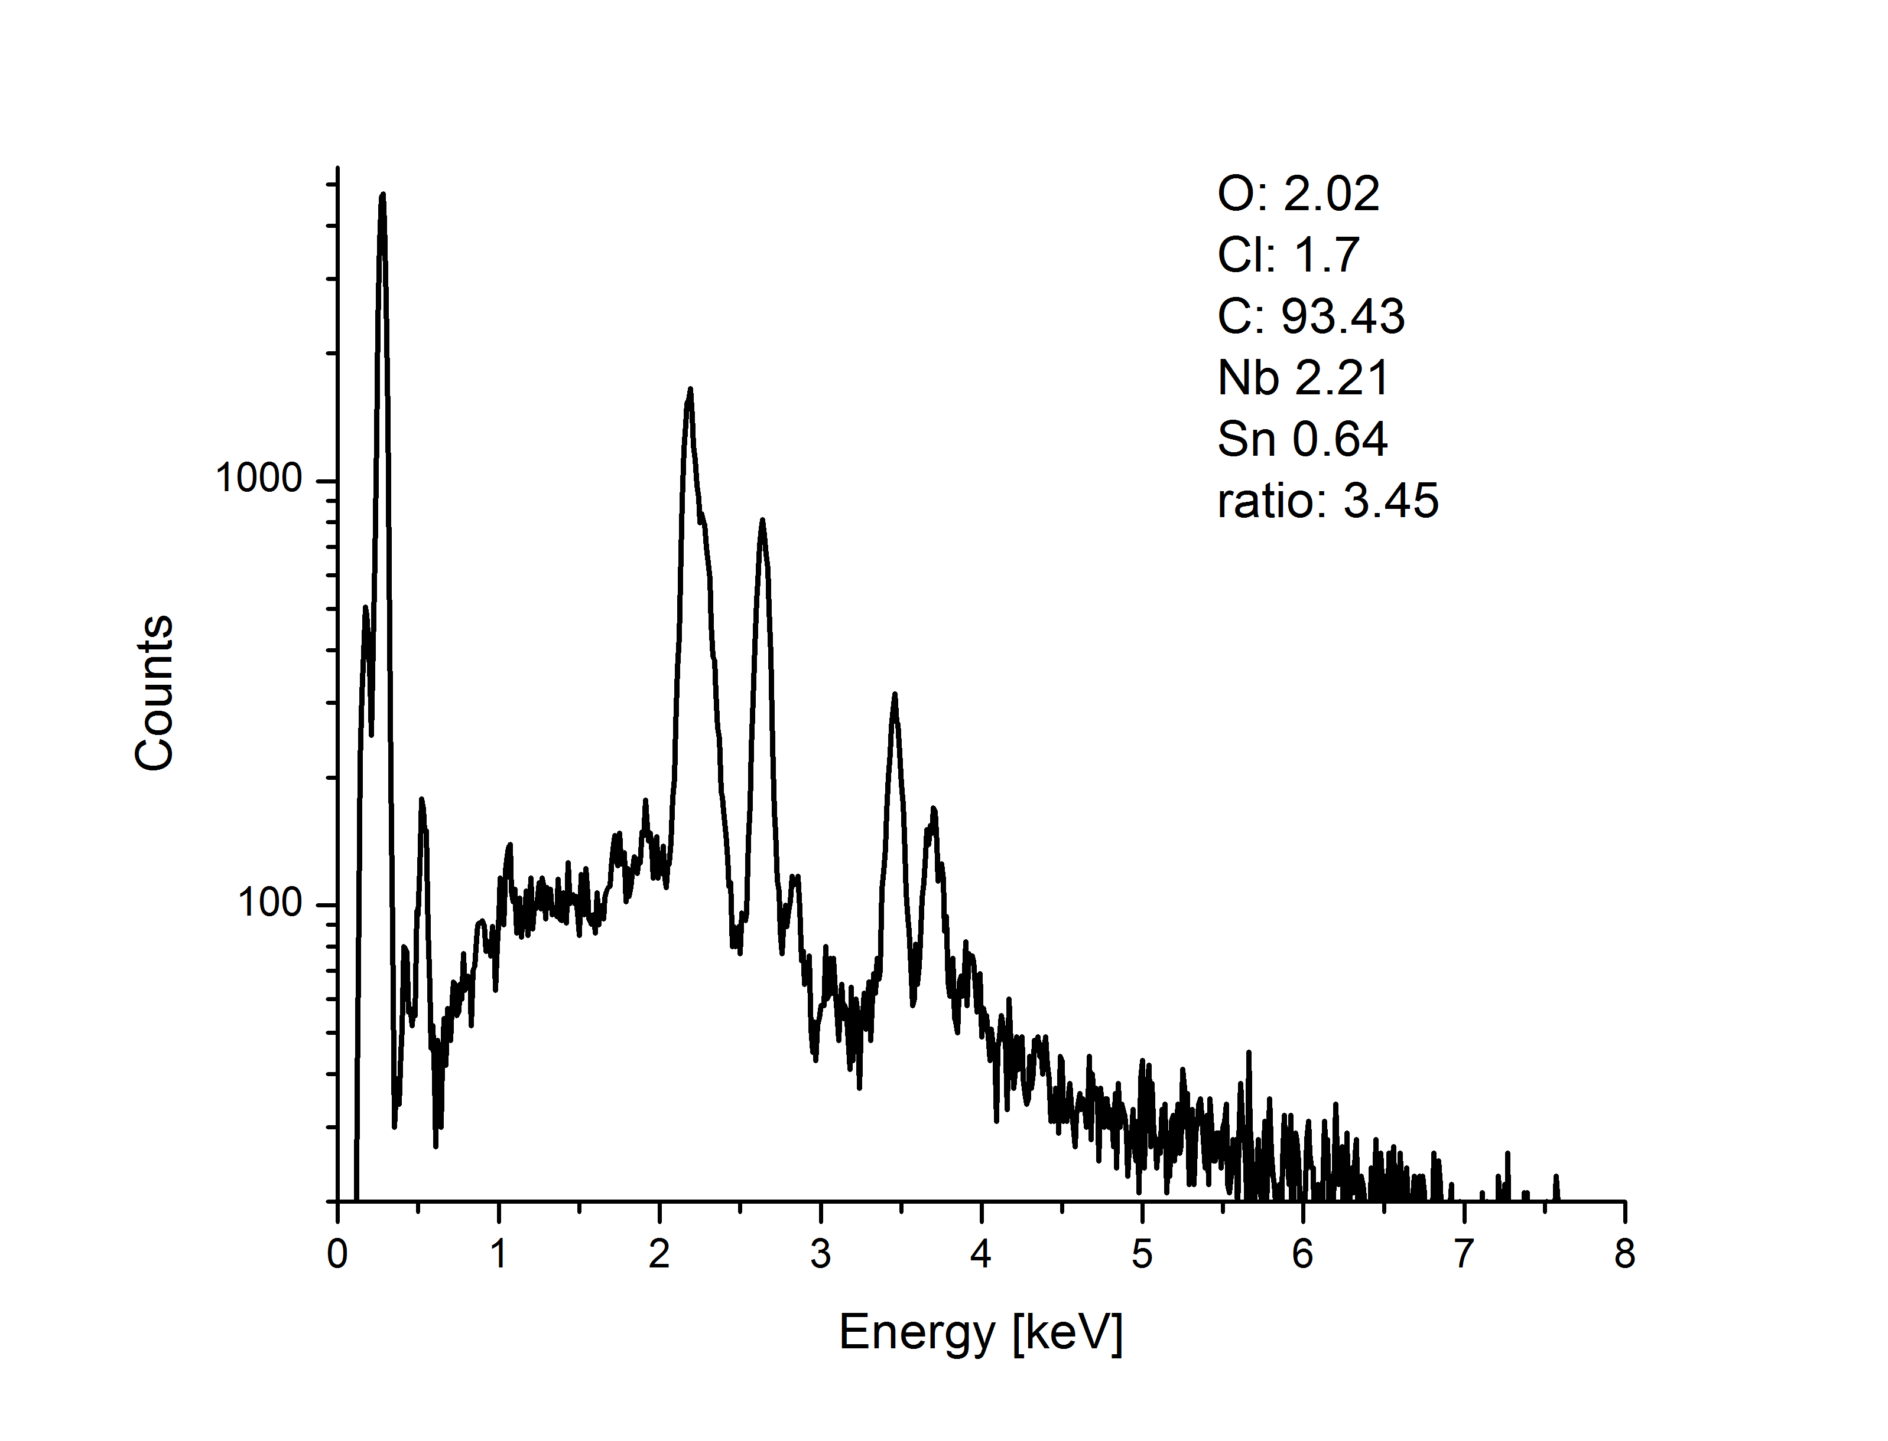
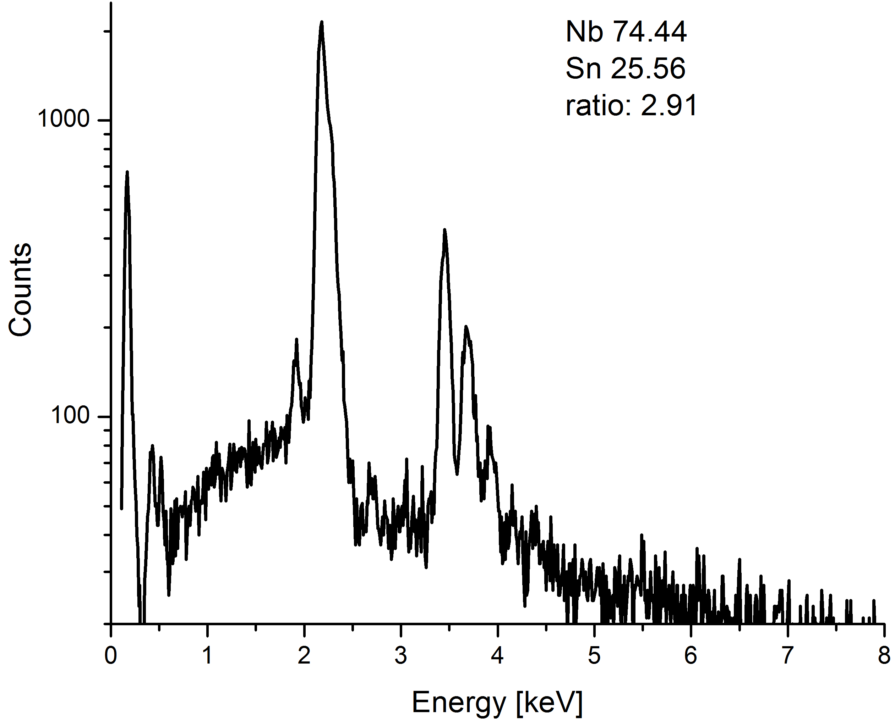
Scanning area

Slide 4
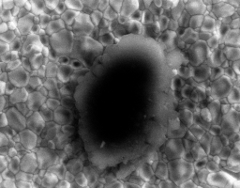
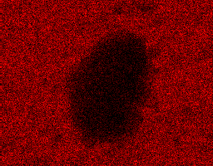
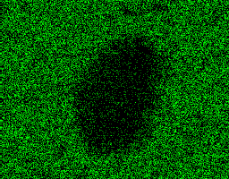
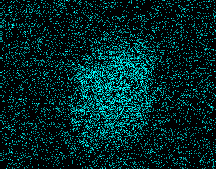
EDX mapping of impurity
Nb L
Sn L
Cl L

Slide 5
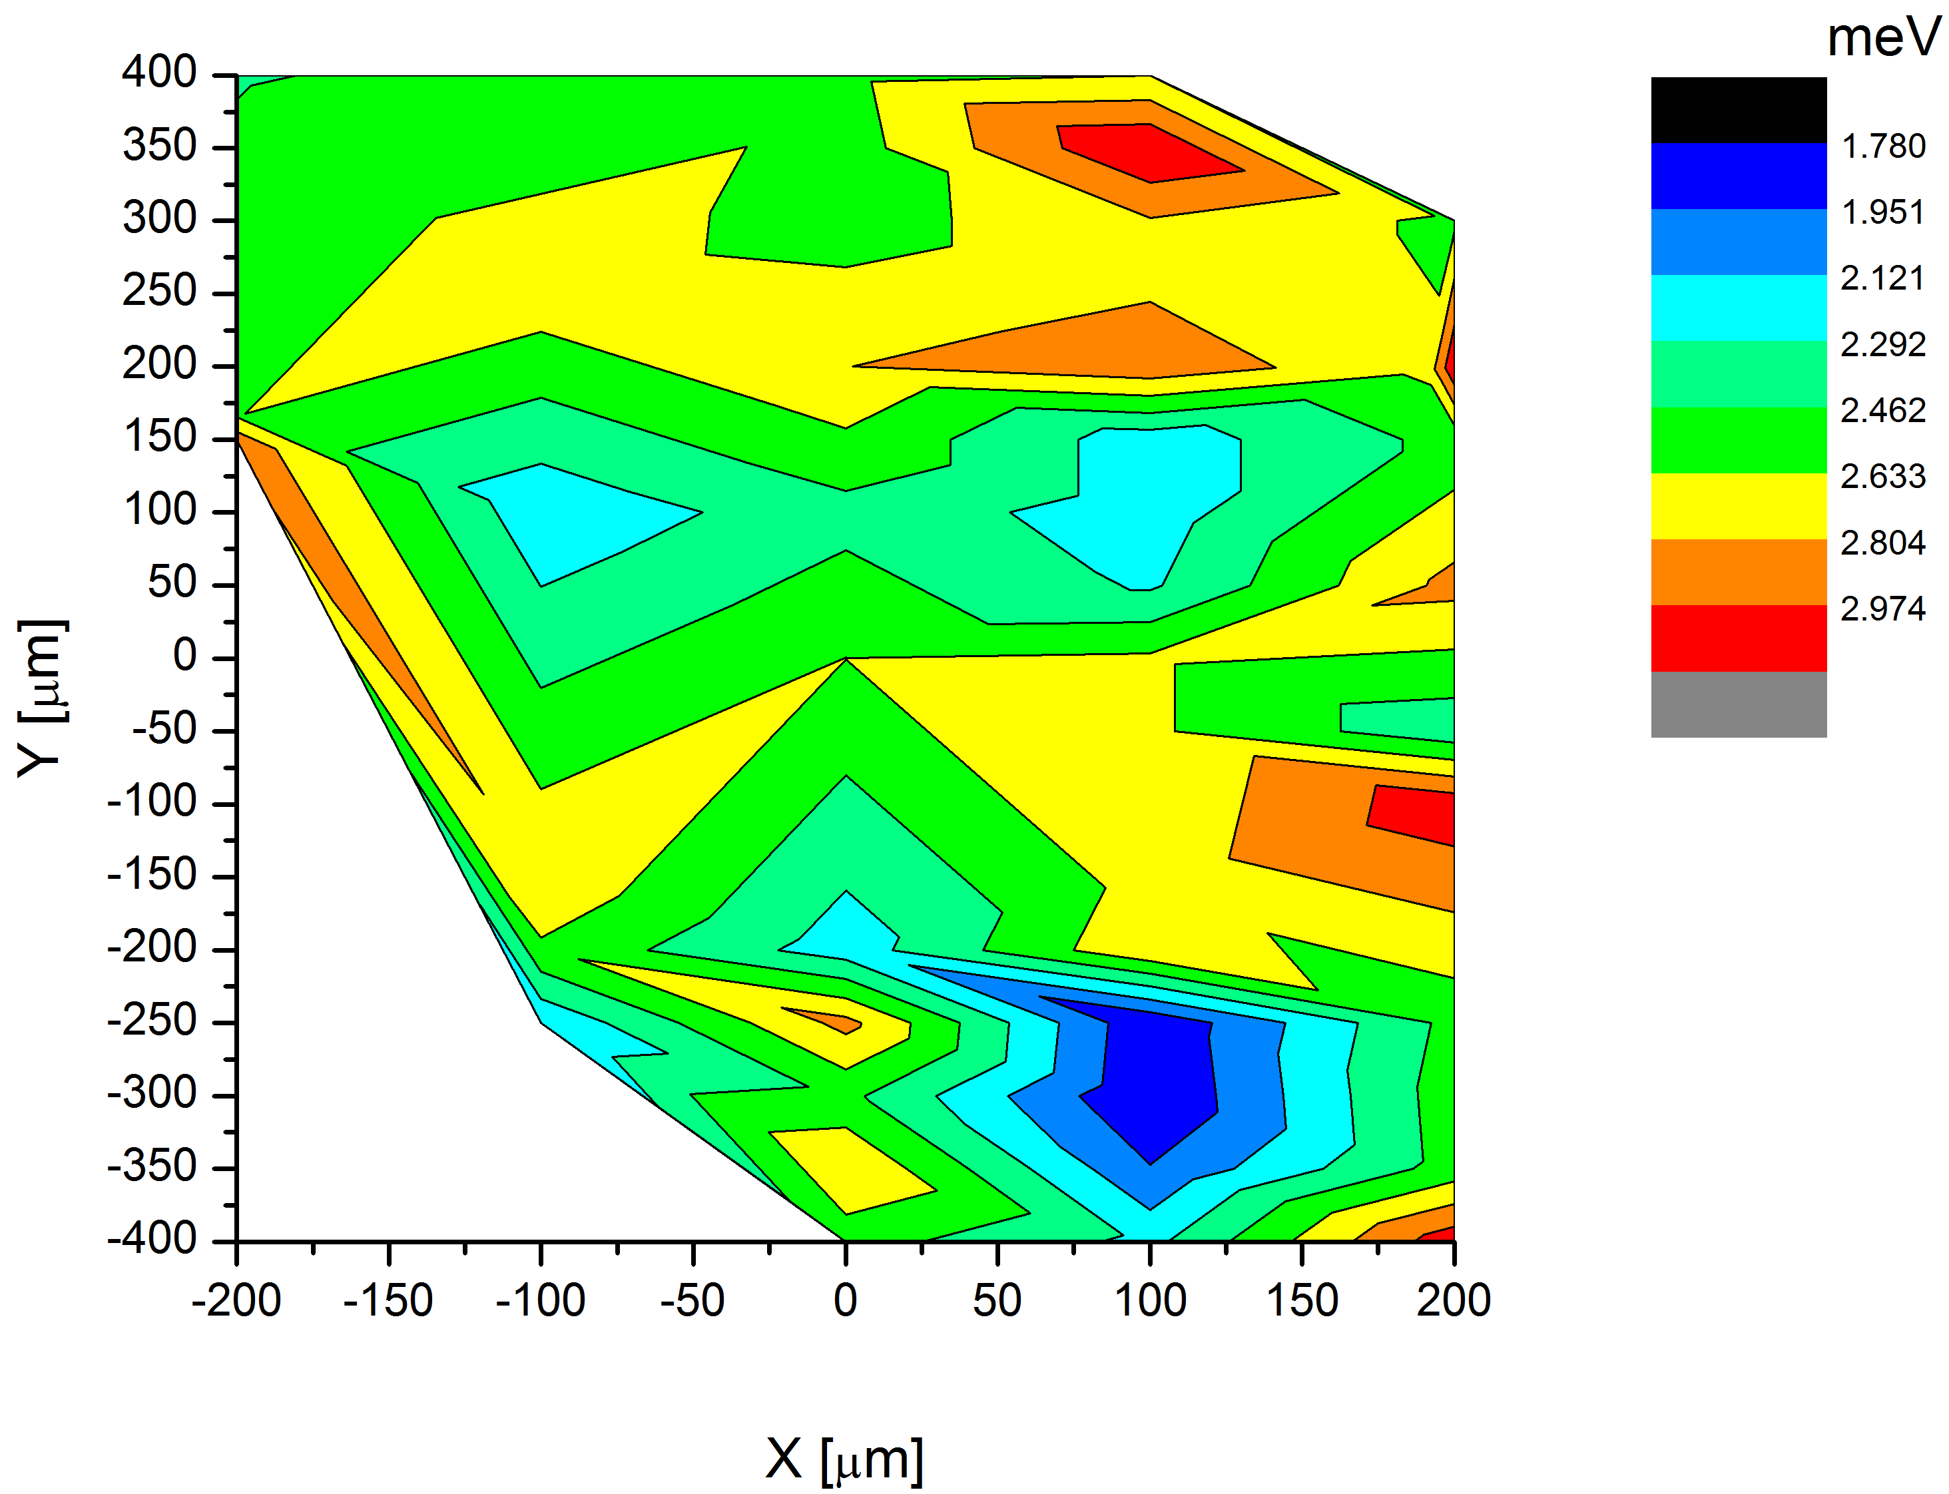
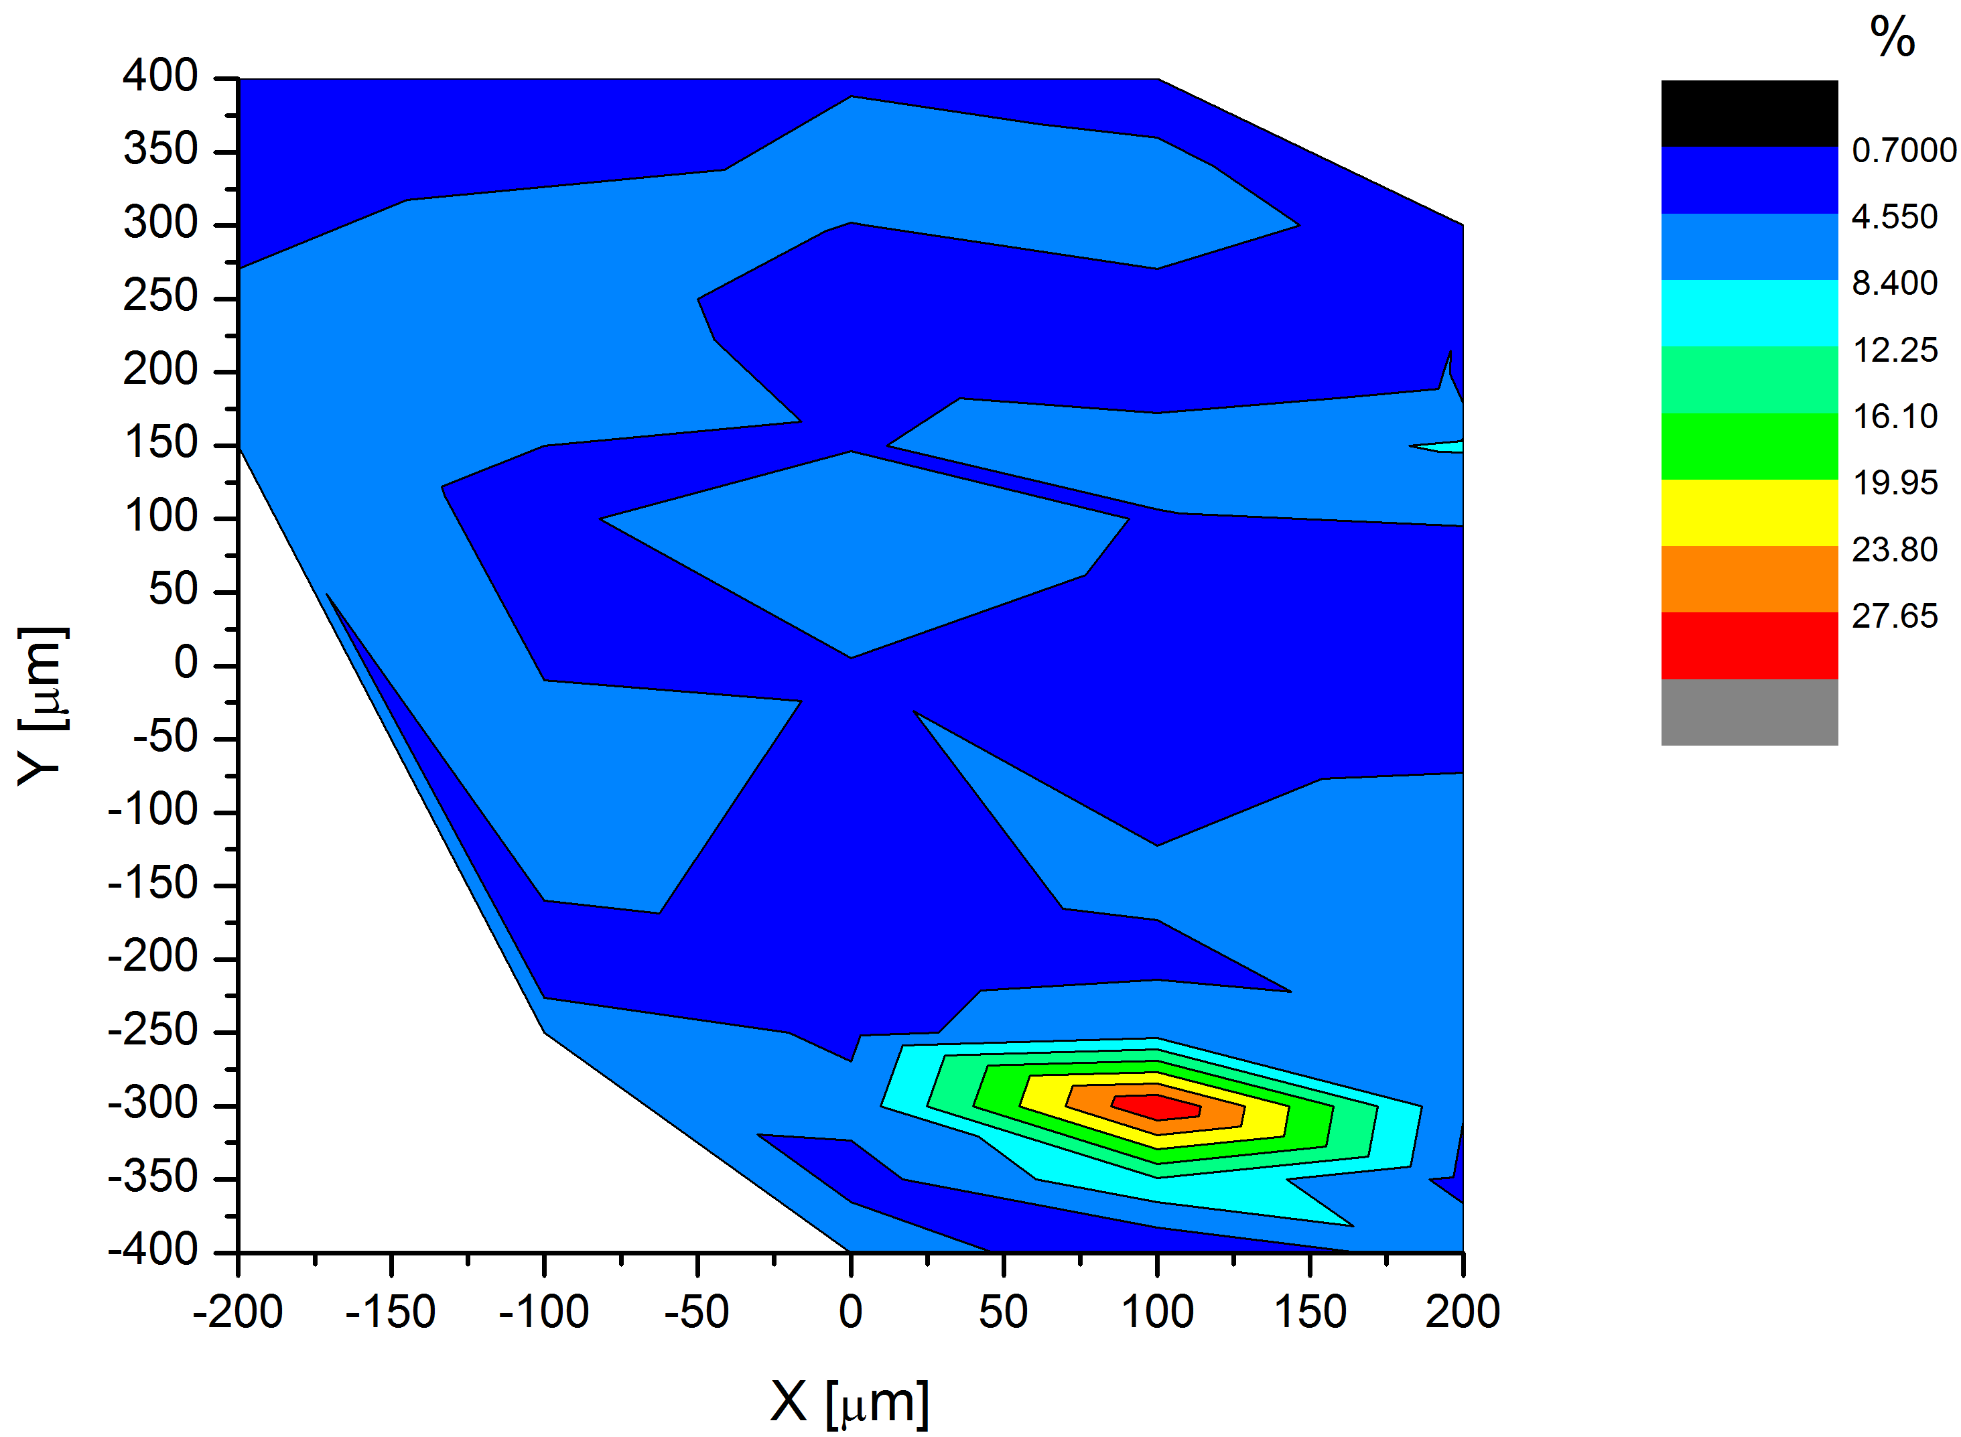
Δ
Comparison SEM-EDX-PCT
Γ/Δ

Slide 6
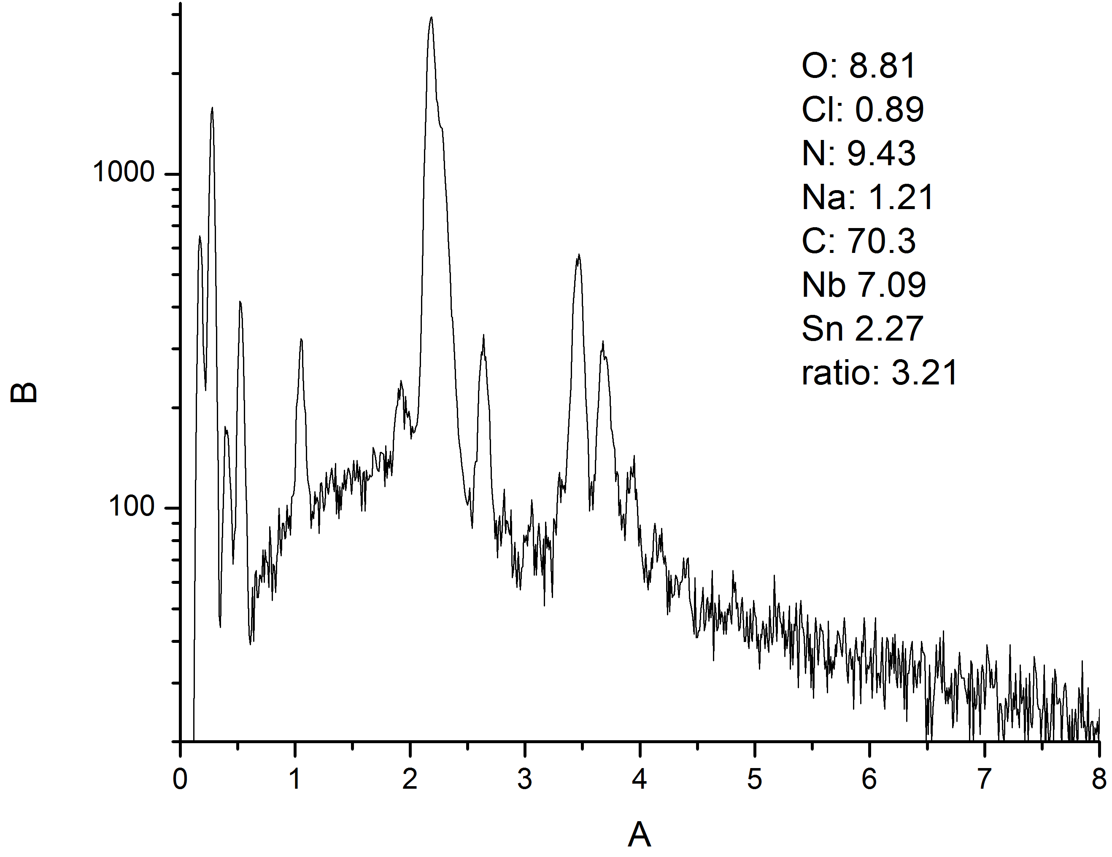
Other impurities

Slide 7
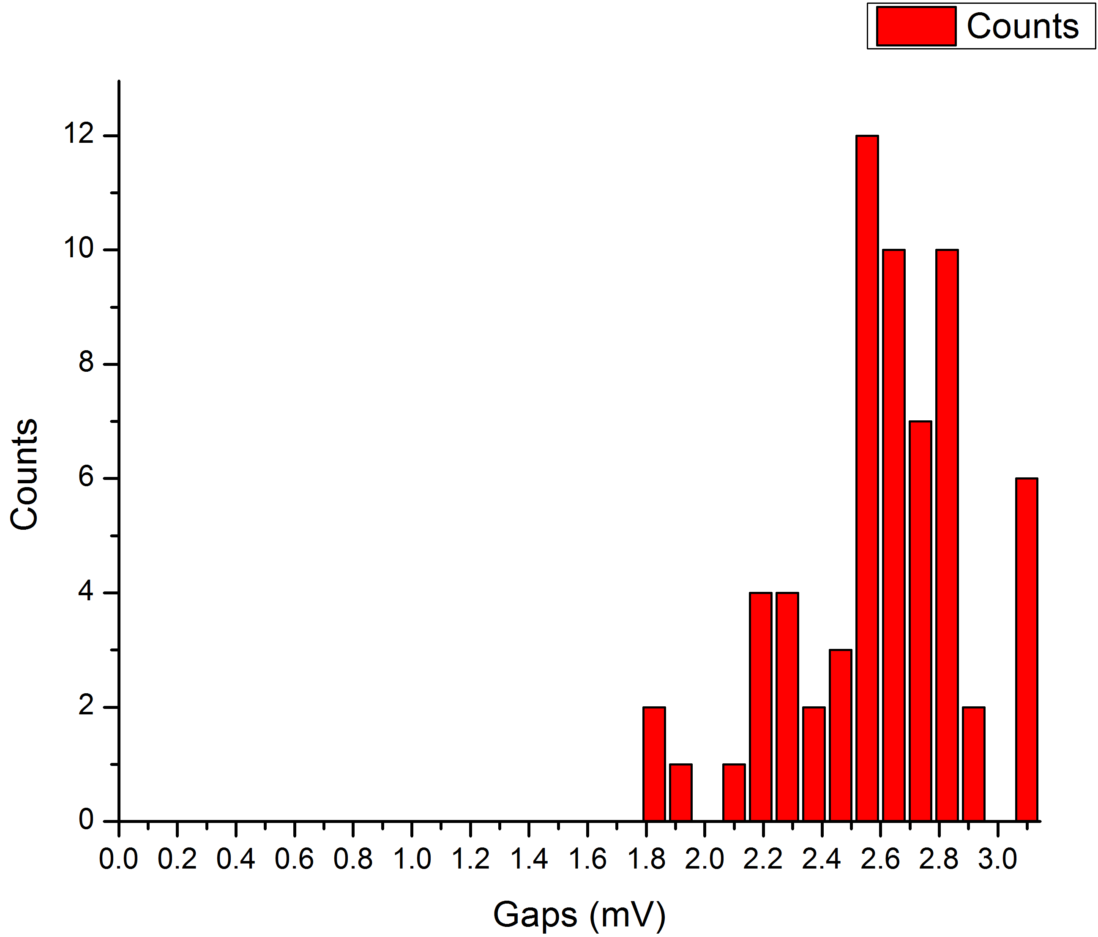
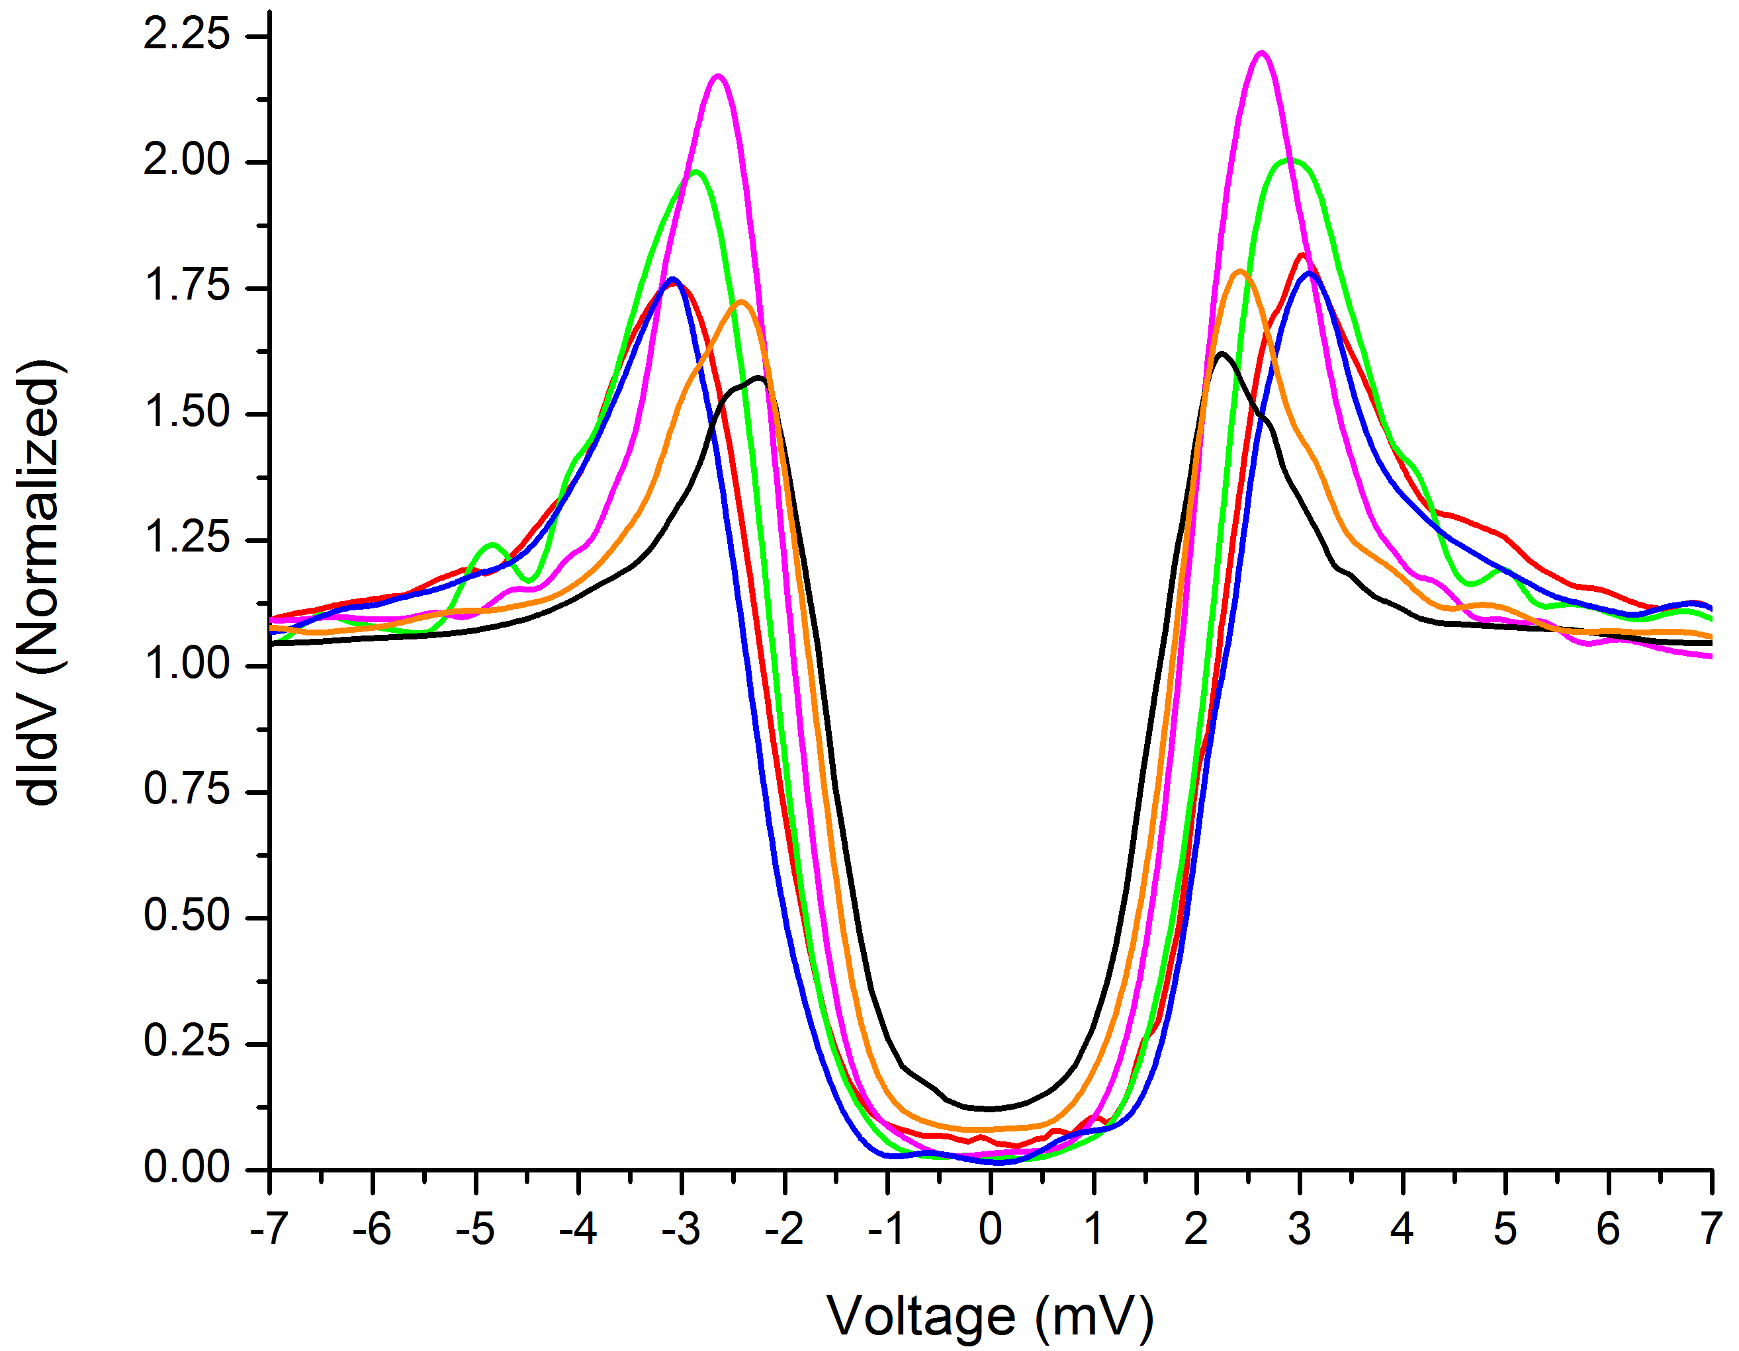
Comparison SEM-EDX
Homogeneity composition in depth?
2.7 meV instead of 3 meV for Nb3Sn
Nb rich surface---just oxide effect?

Slide 8
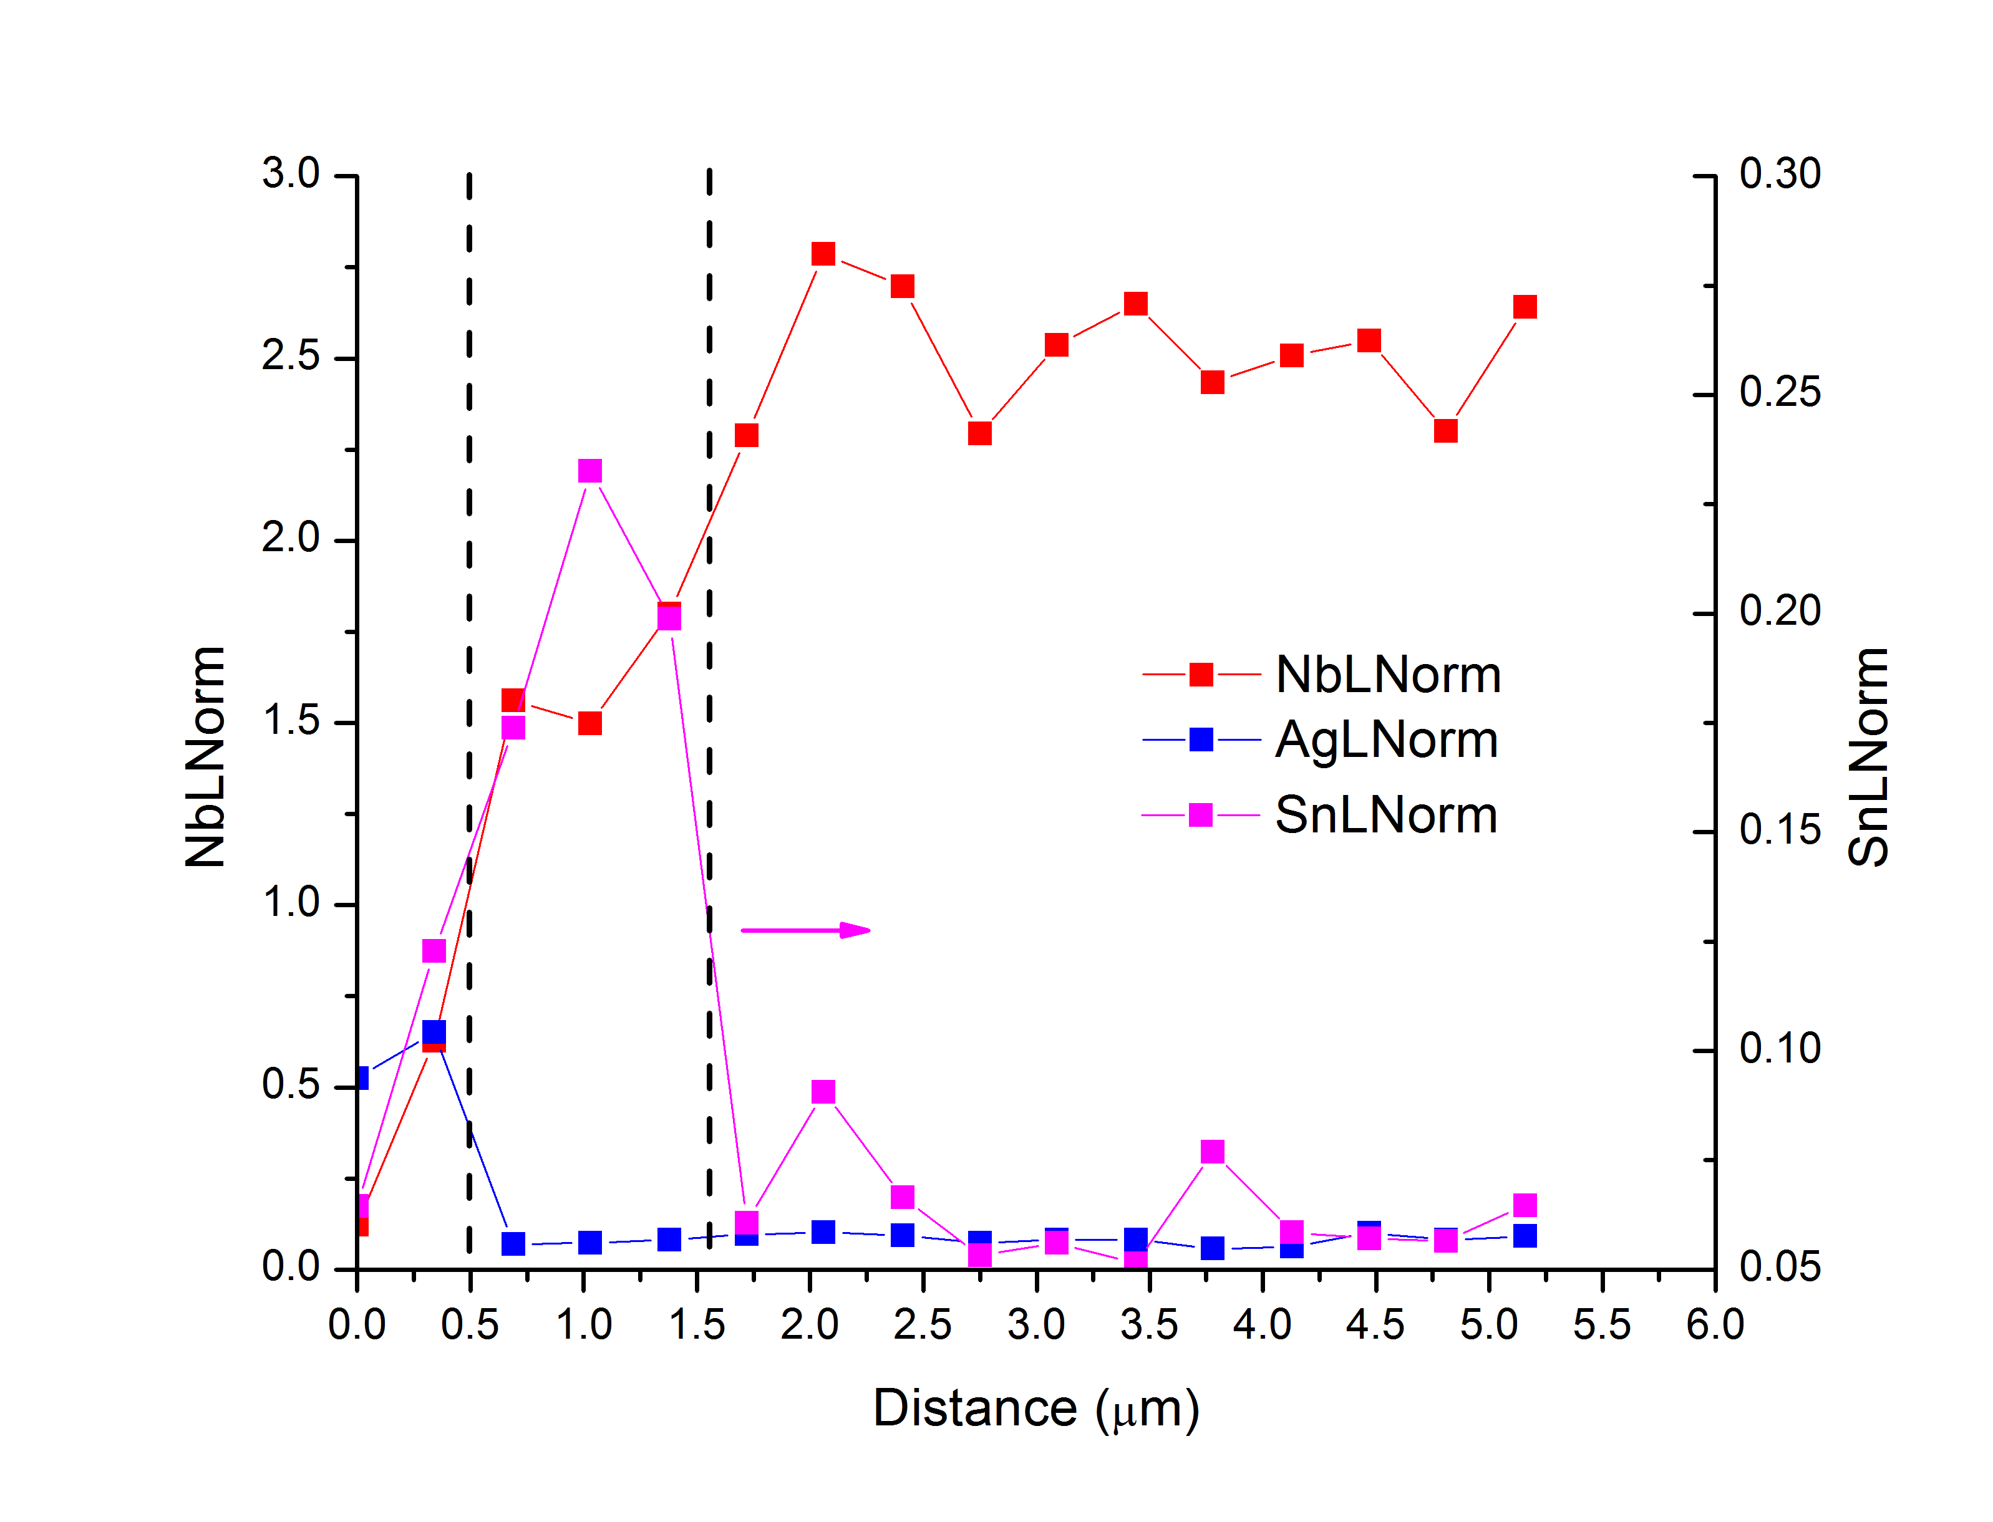
Attempt to do depth profiling
Ag
Nb₃Sn
Nb
7 kV electron beam -> Probing size ~ 300-330 nm (= step size for line scan)
NOT CONCLUSIVE -> TEM NEXT

Slide 9
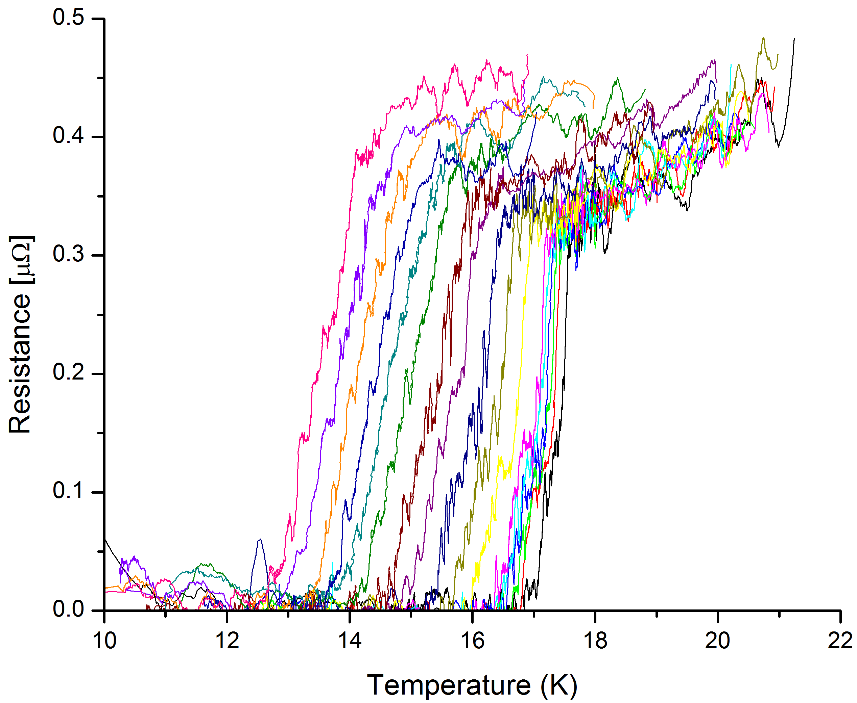
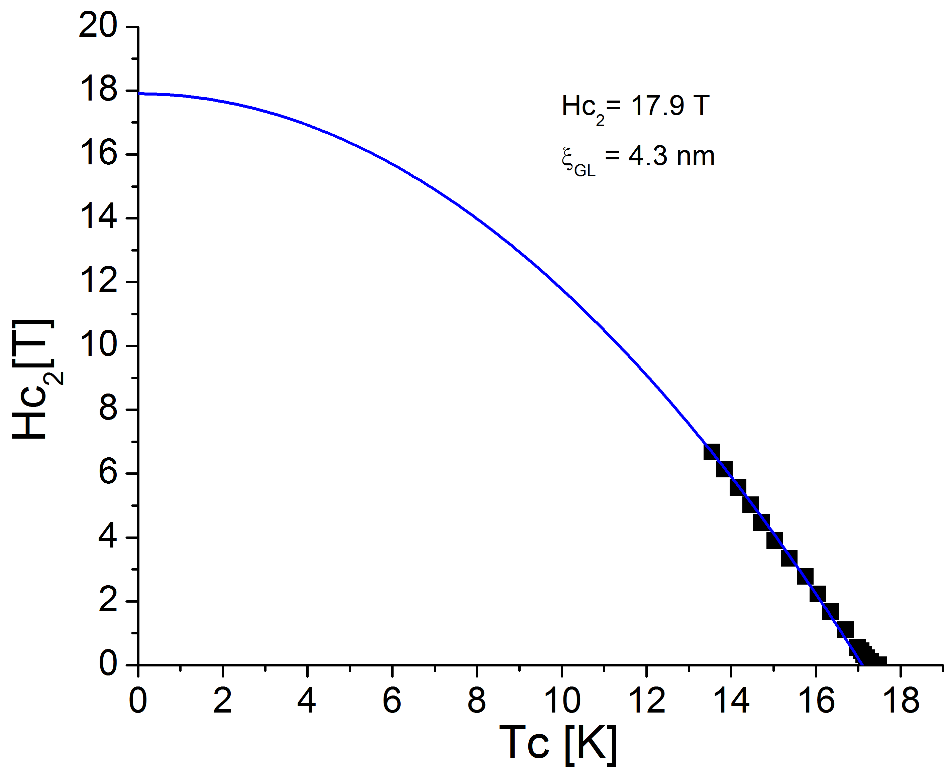
Transport
Tc is taken at half the jump height
Sheet Resistance (= ρ/thick) = 0.341 x Resistance

